Slide 1







Programming Languages: Present and Future
Josh Flieder
27 June, 2022

Slide 2


OUTLINE
Executive Summary
Introduction
Methodology
Results
Discussion
Conclusion
Appendix

Slide 3

EXECUTIVE SUMMARY
JavaScript and HTML are most popular languages and will remain so
Python and TypeScript rising while SQL and Bash/Shell are falling
PostgreSQL database is popular and will become more so
Redis and ElasticSearch databases will jump up soon
MySQL, Microsoft SQL, and SQLite are popular databases but will decrease in popularity

Slide 4
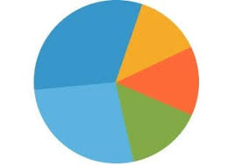
INTRODUCTION
Programming languages drive and underlie many businesses and industries
Knowing the landscape can boost productivity and predict future trends
What programming languages are in demand?
What database skills are most used?
What are the general demographics of programmers?
What are likely changes to these distributions in the short term future?

Slide 5

METHODOLOGY - API’s
Data obtained from Kaggle.com by IBM
Portion of data passed onwards by IBM
Requests module used to grab data
Json method converted format of data
Custom functions used to grab desired data
Openpyxl module used to transfer data to familiar Excel format.

Slide 6

METHODOLOGY - Webscraping
Data obtained from Kaggle.com by IBM
Portion of data passed onwards by IBM
Requests module used to grab data
BeautifulSoup function from bs4 module used to parse html
Custom functions utilized to grab desired data

Slide 7

METHODOLOGY – Data Exploration
Data obtained from Kaggle.com by IBM
Portion of data passed onwards by IBM as a URL
Pandas module use to convert data to DataFrame
Various Pandas methods employed to glean insights from data
head()
shape
dtypes
mean()
unique()

Slide 8

METHODOLOGY – Data Wrangling
Data obtained from Kaggle.com by IBM
Portion of data passed onwards by IBM as a URL
Pandas module use to convert data to DataFrame
Various Pandas methods employed to clean/prepare the data
duplicated(), drop_duplicates()
isnull(), fillna()
mode(),
value_counts(), unique(), head()

Slide 9
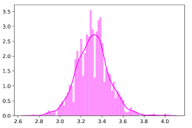
METHODOLOGY – Exploratory Data Analysis
Data obtained from Kaggle.com by IBM
Portion of data passed onwards by IBM as a URL
Various Pandas methods employed to format/plot data
Pandas/Numpy modules for formatting
min(), max(), median(), quantile()
matplotlib and Seaborn for plotting
distplot(), plot(), boxplot(), .corr()

Slide 10
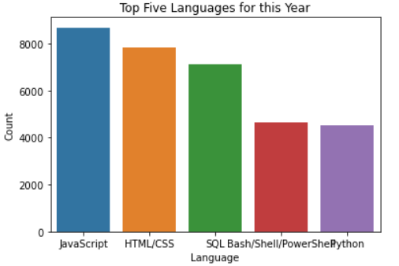
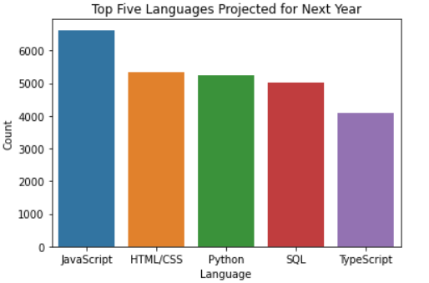
Results: PROGRAMMING LANGUAGE TRENDS

Slide 11
PROGRAMMING LANGUAGE TRENDS - FINDINGS & IMPLICATIONS
Findings:
JavaScript and HTML are and are projected to be the two 2 languages
SQL and Bash/Shell are just behind, but both drop in the future.
Python is closely behind those and is climbing!
Implications:
JavaScript and HTML maintain tops spots
Python and TypeScript gaining in relative use/popularity
SQL and Bash/Shell dropping in relative use/popularity

Slide 12
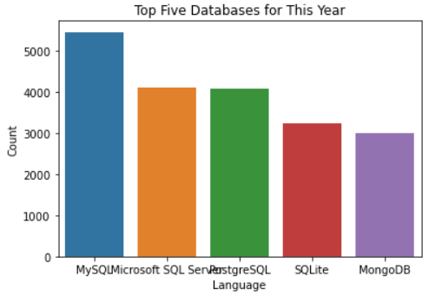
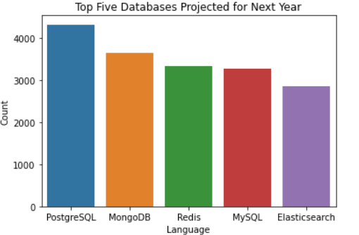
Results: DATABASE TRENDS

Slide 13
DATABASE TRENDS - FINDINGS & IMPLICATIONS
Findings
MySQL is most popular now but will drop in the future.
PostgreSQL popular and will become more so
Microsoft SQL and SQLite popular but will drop significantly
MongoDB popular and rising
Redis and ElasticSearch will jump into top 5 soon
Implications
PostgreSQL, Redis, and ElasticSearch worth investing in
Perhaps best to move away from Microsoft SQL, SQLite, MySQL
MongoDB also worthy on further investment/education

Slide 14
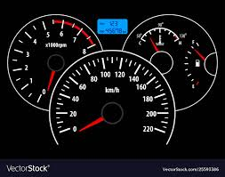
DASHBOARD
<https://dataplatform.cloud.ibm.com/dashboards/dd441547-3410-46cb-b1e8-9d47ba0915c6/view/0107c21d3d9514ce50fddce407992e50743e7159bbbbd007d5817b495c672397f06d1a95c8261f0cd9430232f4e5470acf

Slide 15
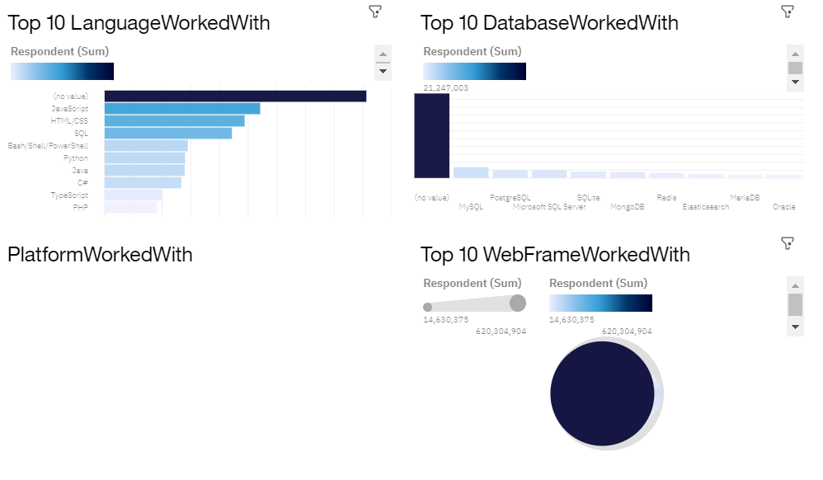
DASHBOARD: Current Technology Use

Slide 16
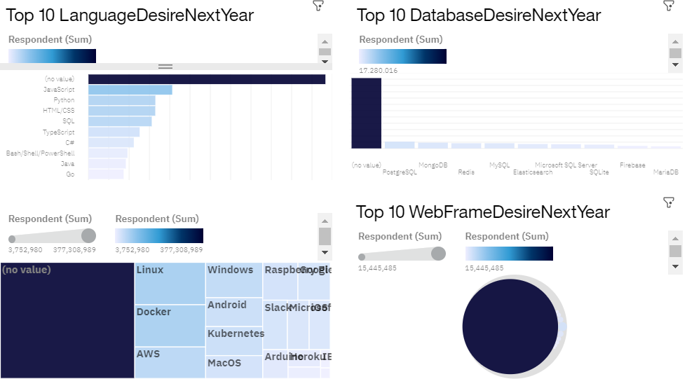
DASHBOARD: Future Technology Use

Slide 17
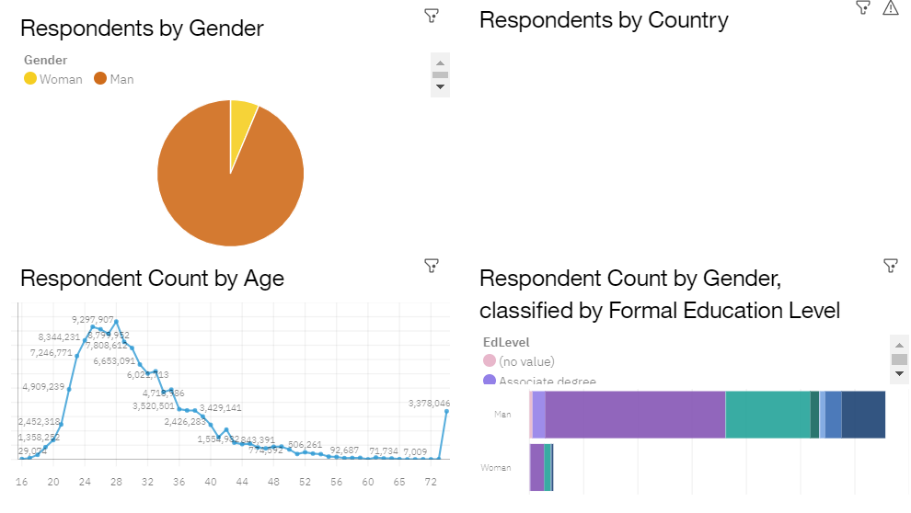
DASHBOARD: Demographics

Slide 18
DISCUSSION
Men in their 20’s dominate the programming field
JavaScript, HTML and Python are and will be strong language choices
MongoDB and PostgreSQL are strong databases with upward momentum
Bash/Shell in a language that is being moved away from
Microsoft SQL, SQLite, and MySQL are databases that are being moved away from

Slide 19
OVERALL FINDINGS & IMPLICATIONS
Findings
Investing in HTML, JS, and Python are and will be top languages
MongoDB and PostgreSQL are and will be top databases
Decrease expected for Microsoft SQL and Bash/Shell
Implications
Investing in HTML, JS, and Python are likely to pay off
Investing in MongoDB and PostgreSQL are likely to pay off
Focusing employee searches on men in their 20’s like to pay off

Slide 20

CONCLUSION
Investing in HTML, JS, and Python are likely to pay off
Investing in MongoDB and PostgreSQL are likely to pay off
Focusing employee searches on men in their 20’s like to pay off

Slide 21
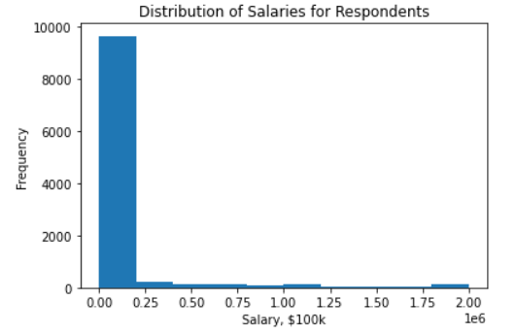
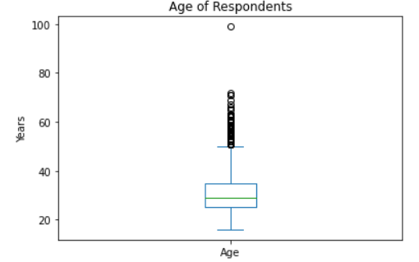
APPENDIX

Slide 22
APPENDIX: Respondent Data

Slide 23
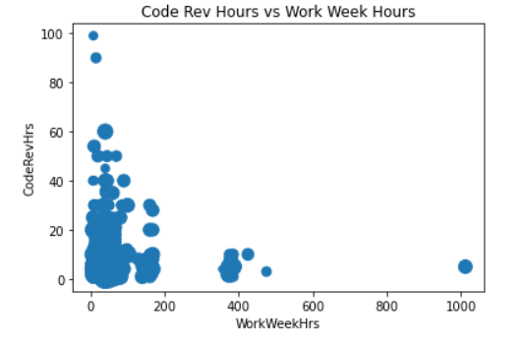
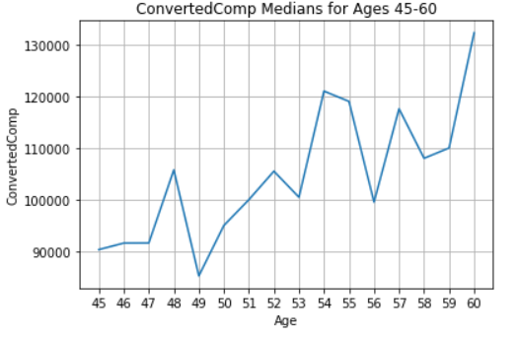
APPENDIX: Respondent Data

Slide 24
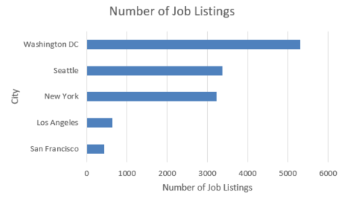
JOB POSTINGS

Slide 25
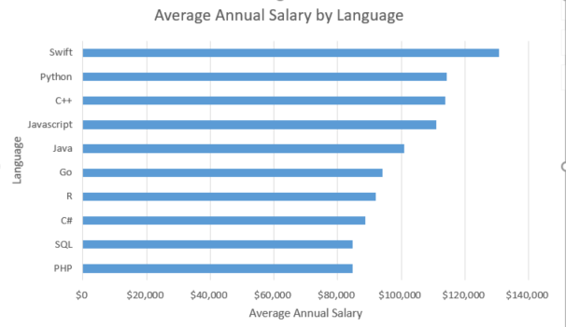
POPULAR LANGUAGES (job listings)

